Slide 1
Optimizing Mixture of Experts Models
EECS 598: Systems for Gen AI
January 25, 2024
Jack Holland (jackholl), Vishwa Ramanakumar (vishram), Ari Singer (arising)
Notes:
Vishwa
We’re going to be discussing what Mixture of Expert models are
We’re gonna go into 2 papers
First is on making MoEs sparse
Second is on interesting innovations made by the Deepspeed team at Microsoft

Slide 2
Outrageously Large Neural Networks: The Sparsely-Gated MoE Layer
Notes:
Vishwa

Slide 3
Motivation: Conditional Computation
Conditional computation is theoretically advantageous
There are challenges in achieving it:
Branching problems
Reduced batch sizes for active network chunks
Network bandwidth bottleneck
Model scarcity comes at the cost of model performance
Existing conditional computation research deals with datasets too small given number of parameters
Notes:
Vishwa
Conditional computation refers to activating/deactivating certain chunks of a network during training based on input tokens
Conditional computation means information propagation through the network is faster during training and testing
Challenges:
Previous work tries to turn off/on large chunks
Conditional computation reduces batch sizes for active network chunks. Batch size is needed to reduce loss from parameter transfers and updating
Inter-device network bandwidth may not be as strong as cluster computational power
Desired model scarcity may come at a cost
Existing work deals with datasets of a few hundred thousand, which is worthless for models with millions and billions of parameters

Slide 4
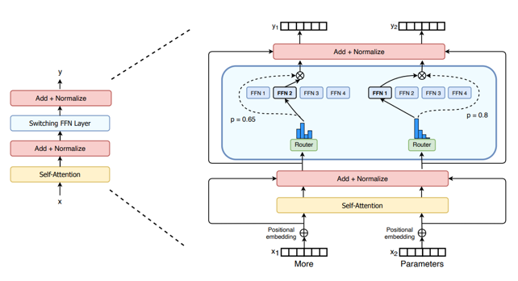
Mixture of Experts:
Notes:
Vishwa
Type of ensemble model
Collection of experts, which are neural networks
In context of conditional computation, only certain experts are fired for a given input
To select which experts are used, gating network used
E.g., if you’re recognizing a car in a picture, you only want to train on the expert that is assigned with recognizing cars
Conceptually, different experts can specialize in a subtask
Diagram:
This is a Switch Transformer encoder block
Replace Feed forward network with a layer of FFN experts
Example shows routing of two separate tokens

Slide 5
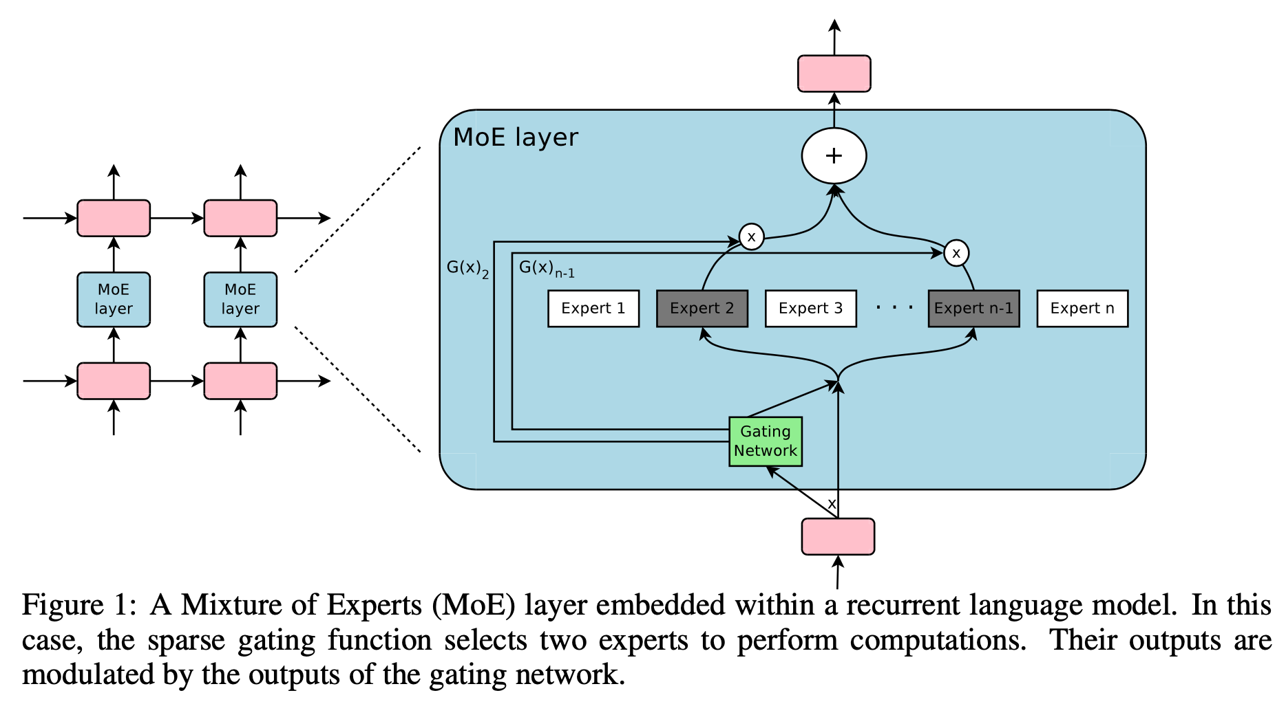
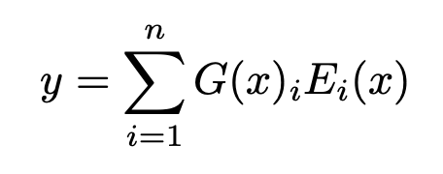
Proposed Structure - Sparse MoE layer
Uses a Mixture of Experts (MoE) layer containing:
Sparse MoE layer with n expert networks (E₁…E_{n})
A gate network/router G outputs sparse n-dimensional vector
MoEs replace Feed Forward Network
Output of the MoE:
Notes:
Vishwa
This paper takes existing architecture and introduces sparsity
This means gating function only selects 2 experts per input
Paper focuses on machine translation and decides to convolutionally apply MoE between LSTM layers as shown in the figure
Layer contains sparse MoE layer with n expert networks
A gate network outputs a sparse n-dimensional vector of 0s and 1s
Output is a weighted sum of the expert outputs.
If Gi is 0, that expert output isn’t calculated in the sum
Saves on computation

Slide 6
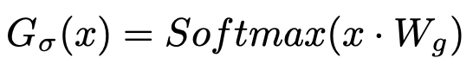
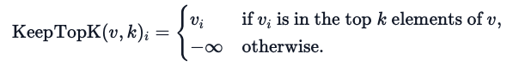
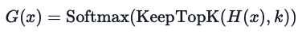
Proposed Structure - Gating
Previous choice of gating function was softmax gating
Noisy Top-K Gating:
Noise
Sparsity
Training:
Use back-propagation
Notes:
Vishwa
Previous choice of gating function was softmax gating
Noisy Top-K Gating:
Noise:
Add tunable Gaussian noise
Helps with load balancing
Controlled by W_{noise}
Sparsity:
KeepTopK adds sparsity
Saves computation
Training:
Use back-propagation

Slide 7
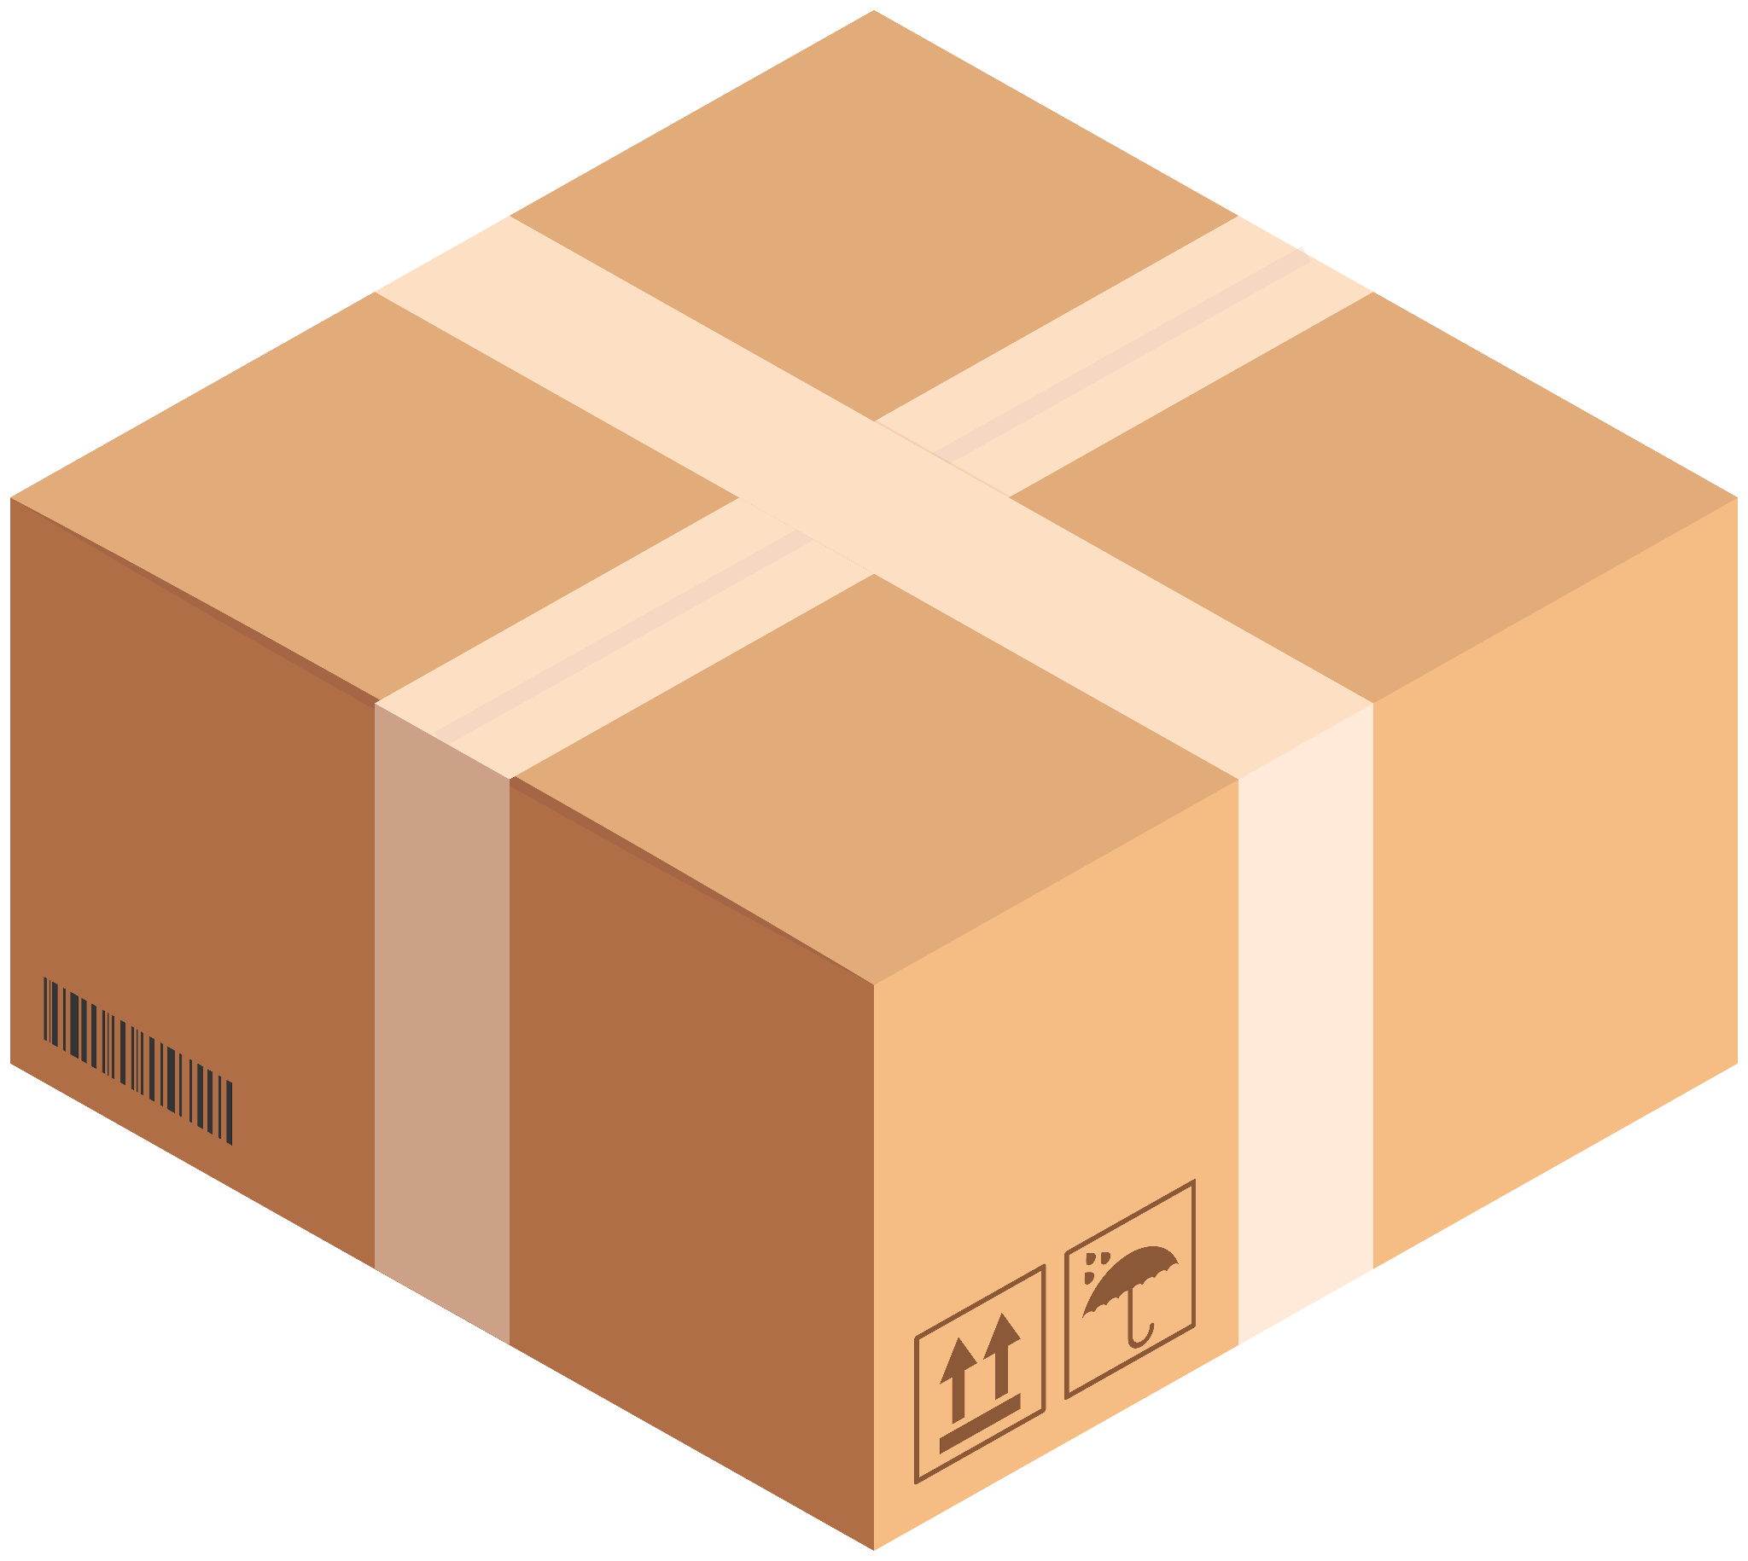

Training Challenge: Shrinking Batch Sizes
Large batches of examples are required in modern GPUs/CPUs
Batch size in a mixture of experts scheme shrinks as gating is more sparse
Notes:
Jack
Large batches of examples are required in modern GPUs/CPUs for computational efficiency
If there are n experts and the gate chooses k of them, then for each batch of b examples, each expert will only receive a batch of size k*b / n

Slide 8
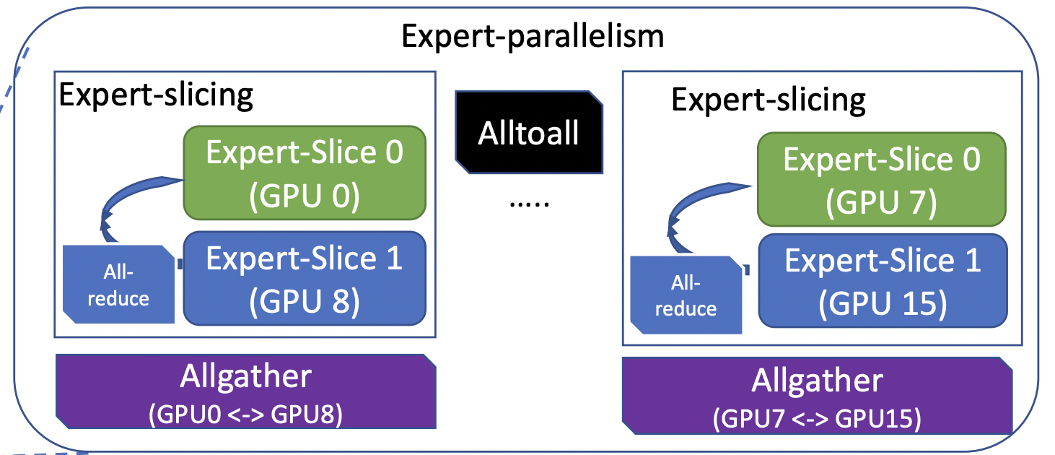
Shrinking Batch Size Solution
Data, Model & Expert Parallelism
Distribute multiple models over multiple devices
Separate experts onto the different devices
Results in increased batch size
Notes:
Jack
Distribute multiple model copies in different devices and synchronously run different batches to all get combined for the MoE layer
Separate experts onto the different devices, only sending the device data for the experts it contains
Increases batch size by the number of devices, can be scaled up to the number of experts k*b*d / n

Slide 9
Shrinking Batch Size Solution
Advantage of Convolutionality
Within the model, apply the same MoE to each time step of the previous layer
Wait for previous timesteps to finish and apply MoE to all timesteps in one big batch
Increases batch size by the number of unrolled timesteps
Notes:
Jack
Apply the same model of MoE to each time step of the previous layer
Wait for previous timesteps to finish and apply MoE to all timesteps in one big batch
Increases batch size by the number of unrolled timesteps

Slide 10
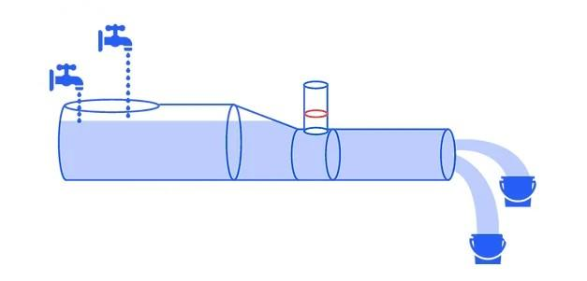
Training Challenge: Network Bandwidth
Most communication to MoE consists of inputs/outputs over the network
Must balance communication to computation for efficiency
Need to increase expert computation enough so expert won’t idle in between training examples
Notes:
Jack
Most communication to MoE consists of inputs/outputs over the network
Need the ratio of each experts computation to its input/output size to be greater than the ratio of computational to network capacity of the device to ensure efficient computation

Slide 11
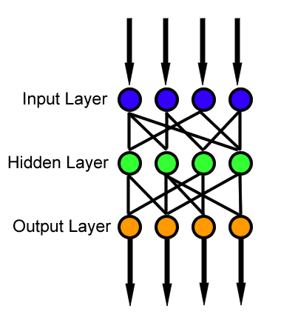
Network Bandwidth Solution
Have each expert be a simple feed-forward neural network with one hidden layer
Amount of computation is decided by the size of the hidden layer
Increase hidden layer size
Notes:
Jack
Have each expert be a simple feed-forward neural network with one hidden layer
Weight matrices would then have the sizes input_size x hidden_layer_size and hidden_layer_size x output_size
Ratio of computation to input and output is therefore the size of the hidden layer
Can therefore increase the size of the hidden layer or add more hidden layers to each expert to be able to increase the computational efficiency up to the device capabilities

Slide 12
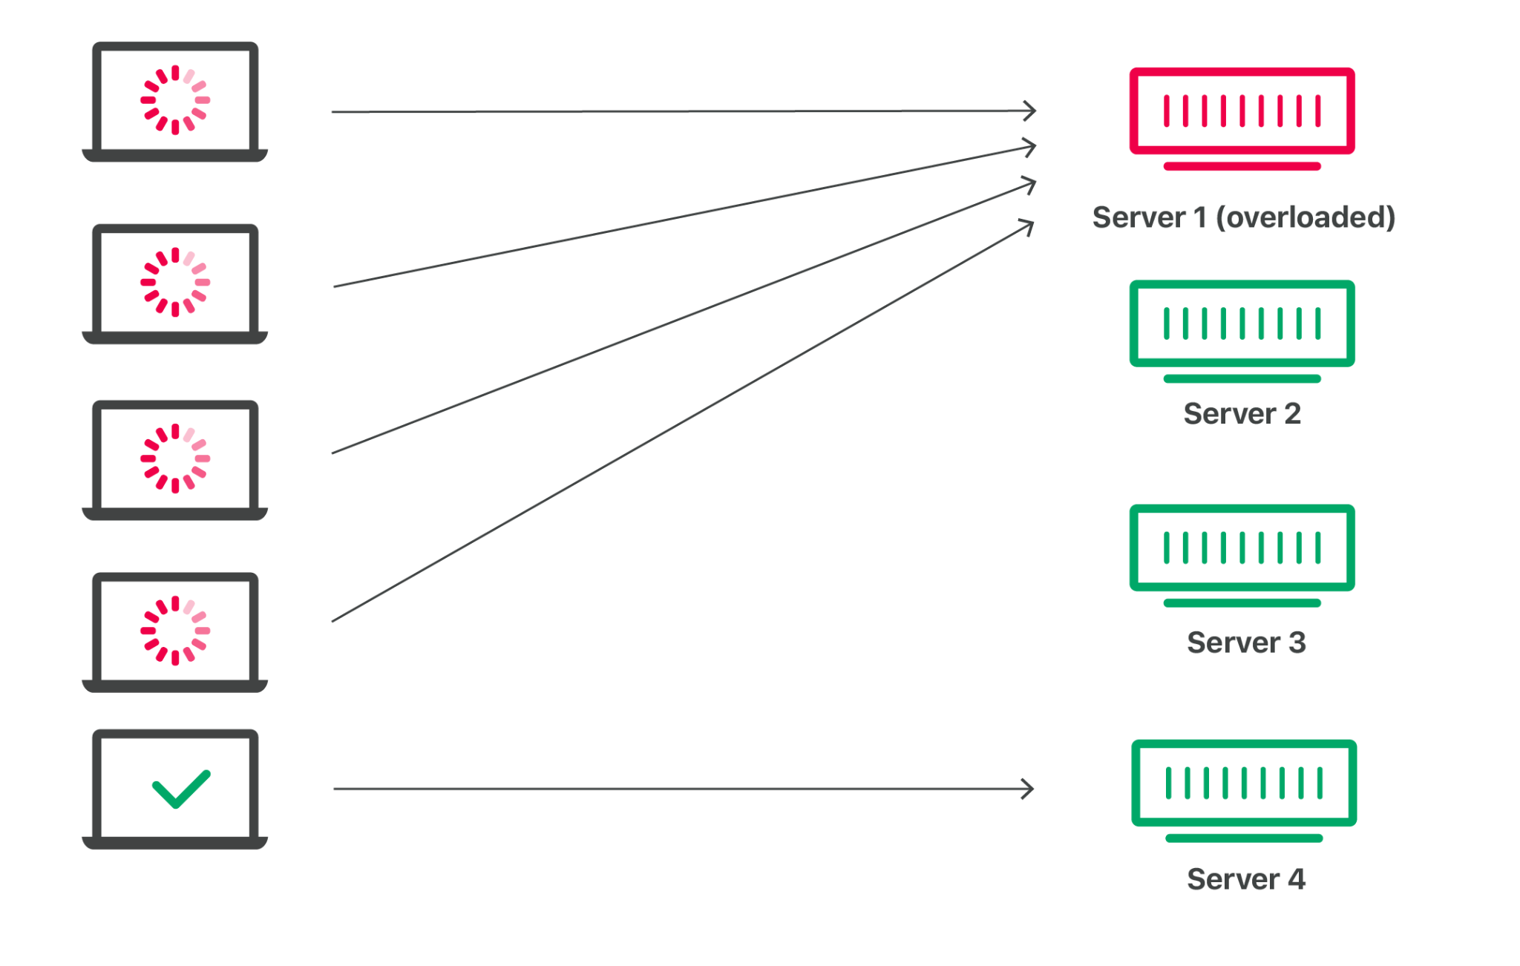
Training Challenge: Expert Balancing
Gating networks tend to favour a few select experts
Need some constraint to ensure experts are trained/selected somewhat evenly
Notes:
Jack
Gating networks tend to favour a few select experts
Favoured experts get trained faster and then are selected even more by the gating network
Need some constraint to ensure experts are trained/selected somewhat evenly

Slide 13

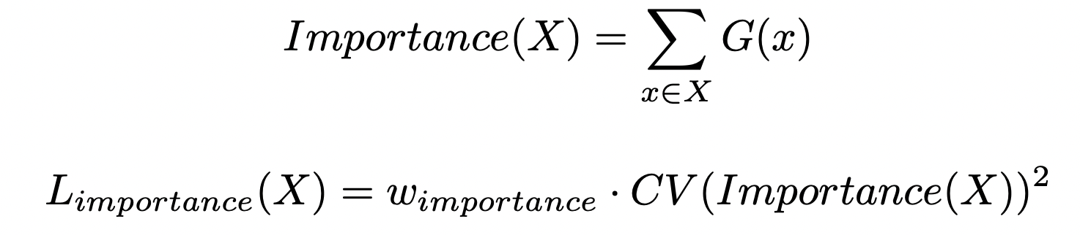
Expert Balancing Solution
Create additional loss functions for variation in gate values and load
Add both loss functions to the model’s overall loss function
Notes:
Jack
Define importance of an expert by its batch-wise sum of gate values
Create additional loss function based on the variation of the all importance values
Create another loss function based on the variation of the load (number of examples) of all experts
Add both loss functions to the model’s overall loss function

Slide 14
DeepSpeed-MoE: Advancing MoE Inference and Training to Power Next-Generation AI Scale
Notes:
ARI

Slide 15
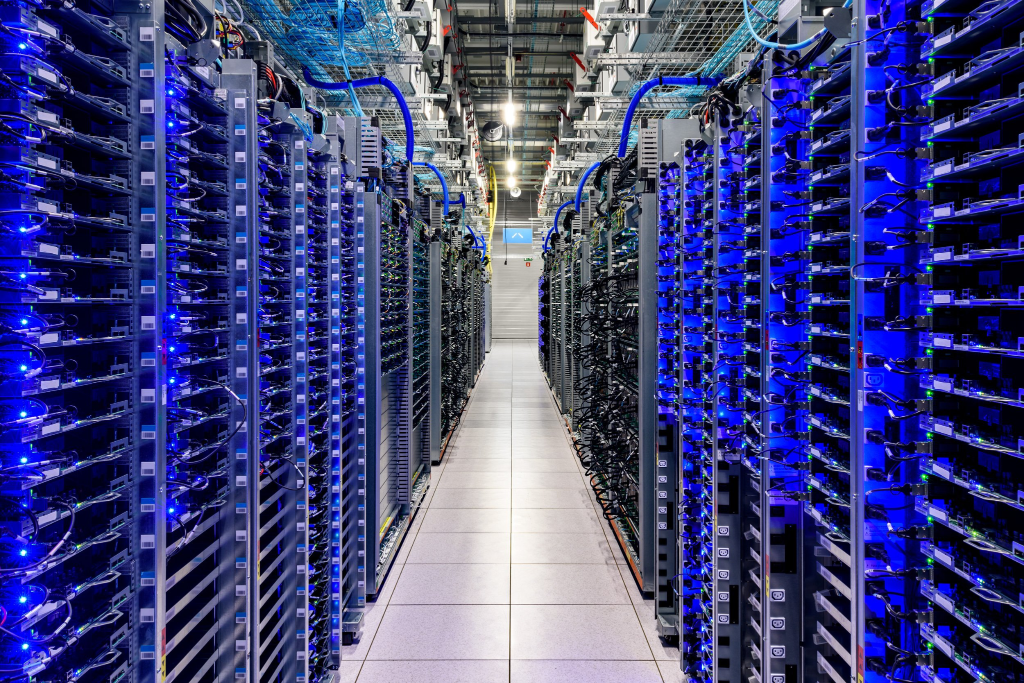
DeepSpeed-MoE – Motivation
Models are getting bigger…
Example: Megatron-Turing NLG 530B took 3M GPU hours
Is it possible to improve quality without increasing cost?
MoE have shown promise, but there are challenges
Notes:
ARI
High demand for larger model size
Increasing model size has been a successful method to increase quality
Sustaining this growth becomes difficult due to compute/cost demands
For example, the Megatron-Turing NLG 530B took 3 months to train on over 2000 A100s, consuming over 3M GPU hours.
Is it possible to make non-trivial improvement to model quality without increasing compute cost?
Is it possible to produce a model with similar quality using 3 to 5 times less resources?
Architectures based on Mixture-of-Experts (MoE) have been shown to allow for improved model quality without increasing training cost.
However, MoE models have their own set of challenges that limit their use in real world scenarios

Slide 16
DeepSpeed-MoE – Challenges
Limited Scope of Current Work
Massive Memory Requirements
Inference Performance
Notes:
ARI

Slide 17
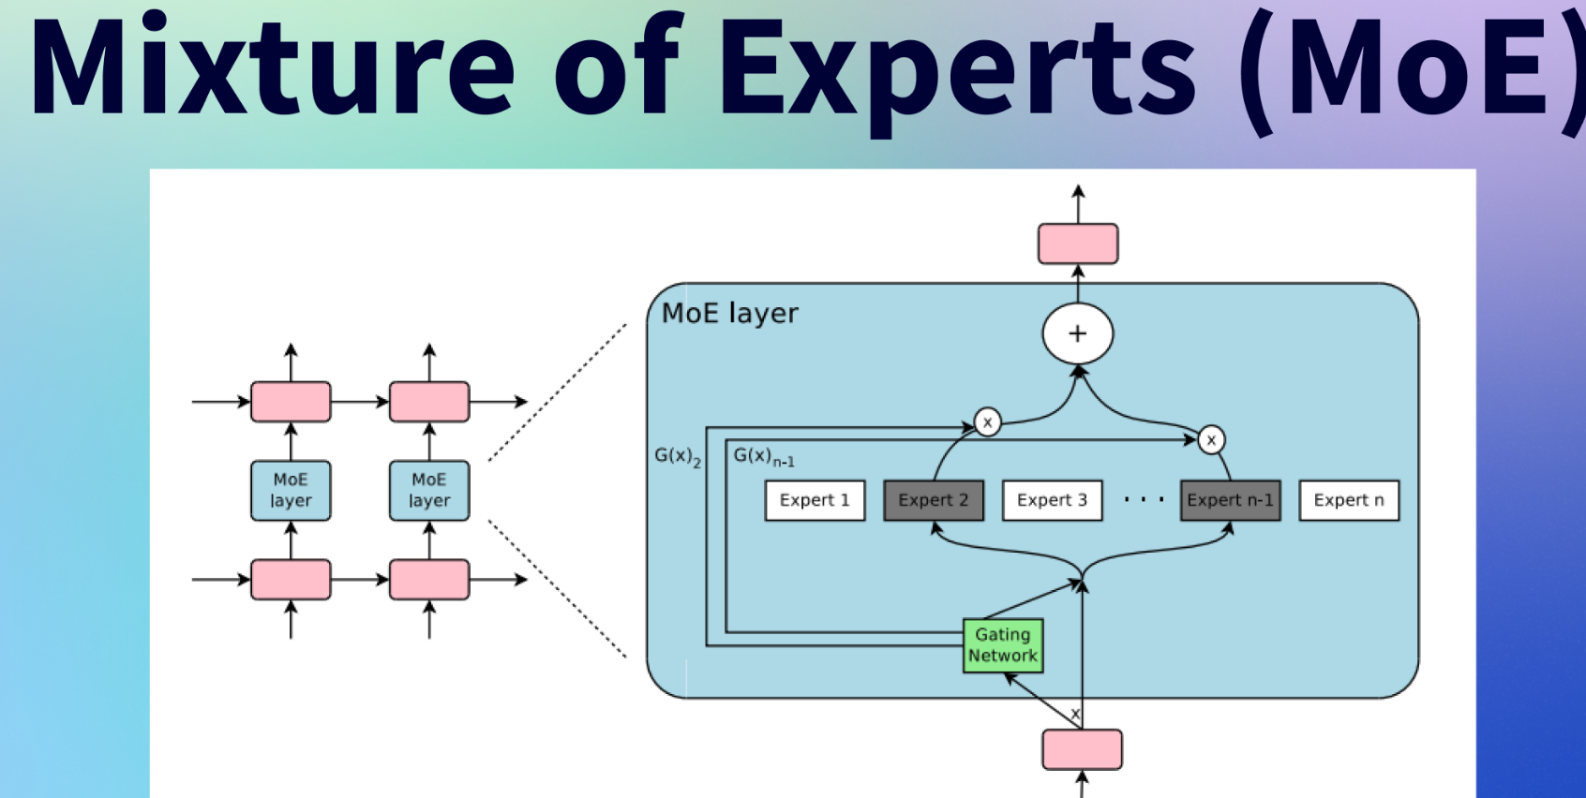

Challenges: Limited Scope
The scope of MoE based models in the NLP area is limited
Application of MoE to auto-regressive NLG is less explored
🤝
Notes:
ARI
The scope of MoE based models in the NLP area is primarily limited to encoder-decoder models and sequence-to-sequence tasks, with limited work done in exploring other domains
Application of MoE to auto-regressive NLG is less explored

Slide 18

Increasing the Scope of MoE
Natural Language Generation (NLG)
Require tremendous compute and energy requirements for training
Much need for cost reductions
Notes:
Jack
Models offer solution to broad range of language tasks
Tremendous compute and energy requirements for training
Applying MoE to an NLG model could offer great cost reductions without a hit to quality

Slide 19
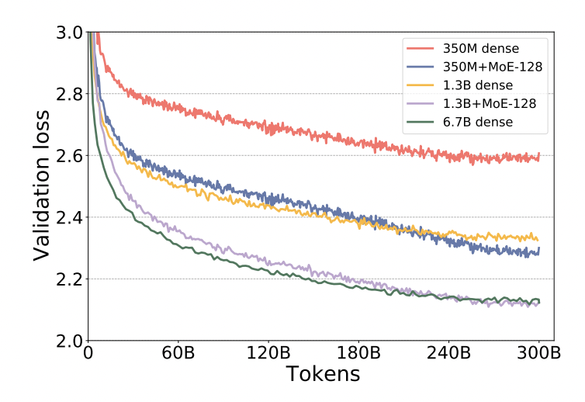
Increasing the Scope of MoE
MoE based NLG Model Architecture
Add interlayed layer of experts
Training tests show increased quality at lower cost
Notes:
Jack
Added layer of experts on every other feedforward layer
Used a gating function to select the top-1 expert
MoE creates better quality for NLG models
Experts increase performance but do not change the compute requirements of the model as each token is only processed by a single expert
Can achieve the same quality at 5x less cost

Slide 20
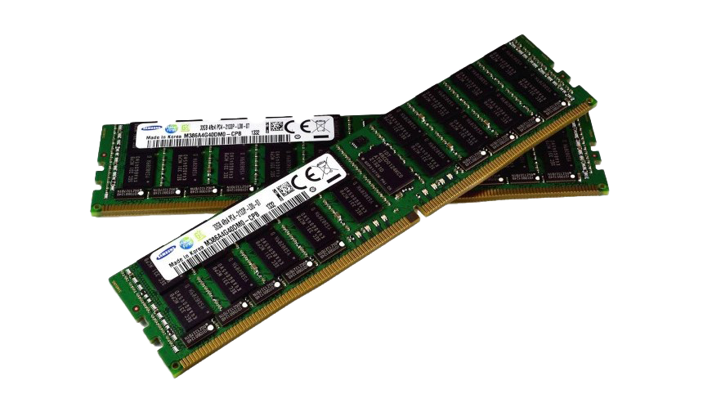
Challenges: Memory Requirements
MoE model requires significantly more parameters (experts) than dense model counterparts
Low parameter efficiency compared to quality-equivalent dense models brings challenges to both training and inference
Notes:
ARI
MoE model requires significantly more parameters (experts) than dense model counterparts
Essentially, MoE models have a lower parameter efficiency compared to quality-equivalent dense models. This brings challenges to both training and inference
We would like to increase parameter efficiency and shrink the model where possible

Slide 21
Memory Solutions
Prior MoE work has reduced training cost but at the expense of model size
Model size increases → memory requirement increases → Memory bandwidth consumption increases → inference performance bottleneck
Two advances are proposed:
Pyramid-Residual-MoE
Mixture-of-Students
Notes:
Vishwa

Slide 22
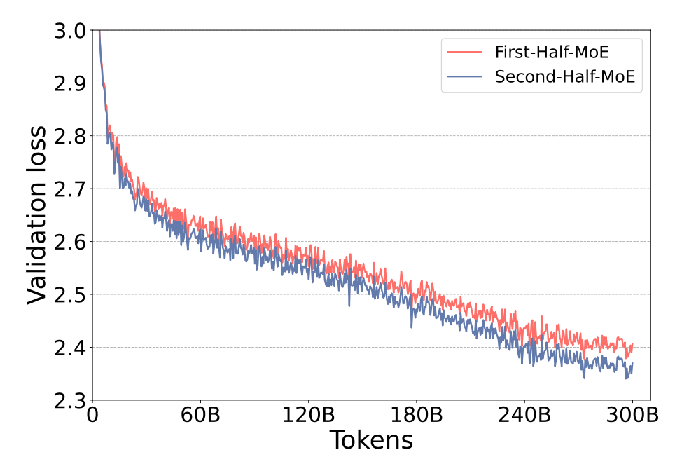
Pyramid-Residual-MoE: Phenomenon 1
In standard MoE, all layers have same expert count
Do all layers learn the same level of representations?
Second-Half MoE better than First-Half MoE
Notes:
Vishwa
CV: shallow layers learn general representations, deep layers learn specific representations.
Can conclude, representations learnt aren’t the same

Slide 23
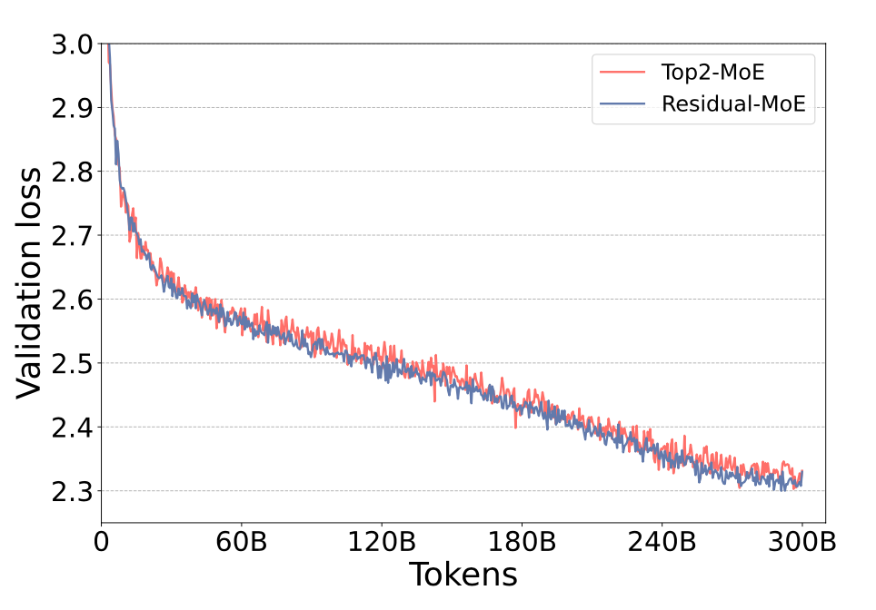
Pyramid-Residual-MoE: Phenomenon 2
Two ways to improve generalization performance of MoE:
Increase expert count and maintain expert capacity (k)
Double expert capacity and maintain expert count
Intuition: For larger k, can you fix the first expert?
Experiment:
Double capacity (Top2-MoE)
Fix one expert and vary second expert (Residual MoE)
Notes:
Vishwa
Two ways to improve generalization performance of MoE:
Increase expert count and maintain expert capacity (k)
Increases memory requirements, defeats purpose
Double expert capacity and maintain expert count
Increases communication volume of gate network G
Intuition: For larger k, can you fix the first expert?
Experiment:
Double capacity (Top2-MoE)
Fix one expert and vary second expert (Residual MoE)
MLP module plus error correction expert
Eliminates additional communication cost
10% faster than Top2-MoE
The experiment attempts to mitigate communication costs
Single expert is a multilayer perceptron module

Slide 24
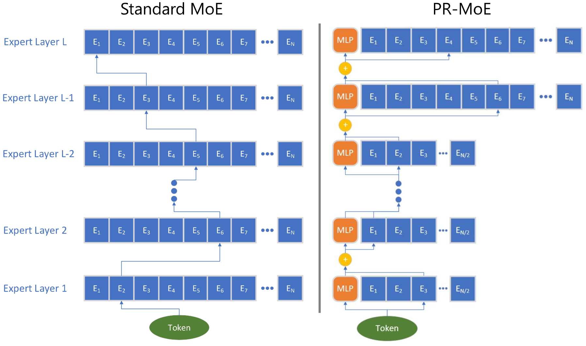
Pyramid-Residual-MoE Architecture
Combining the outcome of Phenomenon 1 and 2, we get PR-MoE:
More experts in last half layers
Fixed MLP module
Notes:
Vishwa

Slide 25
Pyramid-Residual-MoE: Challenges
Incorporating expert parallelism is difficult given varying expert counts by layer
Utilize multi-expert and multi-data parallelism support:
E.g. 128 GPUs with 32, 64, 128 experts per layer can have 32, 64, 128 expert parallelism and 4, 2, 1 data parallelism.
Each GPU trains 1 expert per MoE layer regardless of expert count so tokens per expert maintains, no load imbalance, and no increased memory requirements
Notes:
Vishwa
Incorporating expert parallelism is difficult given varying expert counts by layer
If degree is set to smallest layer, then multiple experts per GPU → reduce batch size per expert → inefficiency, increase memory requirements
If degree set to largest layer, then load balancing problem
Utilize multi-expert and multi-data parallelism support:
Different layers have different degrees of expert and data parallelism
E.g. 128 GPUs with 32, 64, 128 experts per layer can have 32, 64, 128 expert parallelism and 4, 2, 1 data parallelism.
Each GPU trains 1 expert per MoE layer regardless of expert count so tokens per expert maintains, no load imbalance, and no increased memory requirements

Slide 26
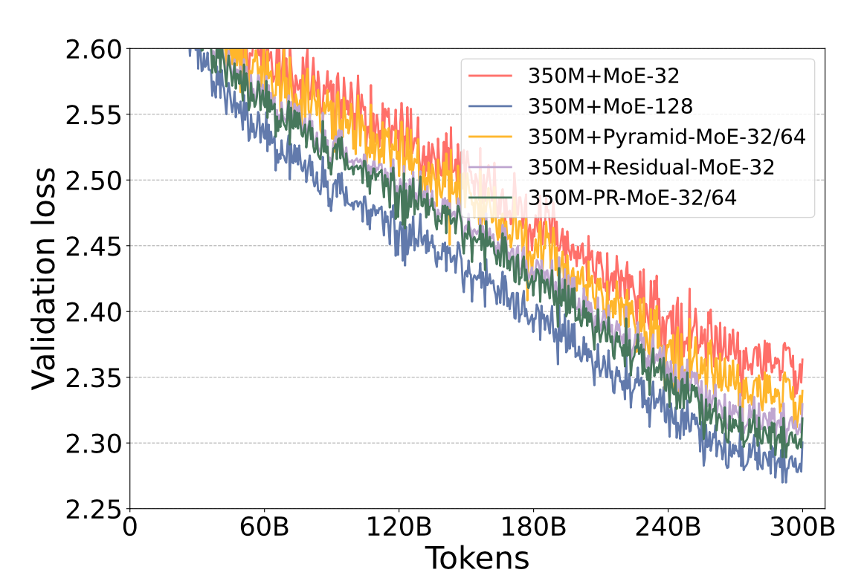
Pyramid-Residual-MoE: Evaluation
Goal of evaluation is to minimize loss of performance by reducing expert count while reducing memory requirements
350M+PR-MoE-32/64 has validation gap of only 0.01 from 350M+MoE-128
Notes:
Vishwa

Slide 27
Mixture-of-Students: Even further optimization
Knowledge distillation (KD) is a proven technique used for reducing model size and computation
Existing research on KD only focuses on pre-trained LLMs of a few hundred parameters
Some work condenses MoE into dense models, but this defeats the purpose
Mixture-of-Students method presents a unique approach
Notes:
Vishwa

Slide 28
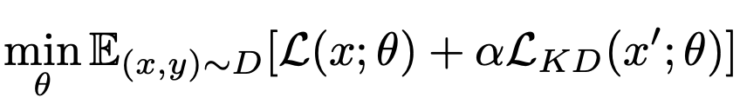
Mixture-of-Students: Architecture
First train teacher PR-MoE model
Depth of each expert branch is reduced to get a student
Resulting model is titled PR-Mixture-of-Students (PR-MoS)
Same sparsity as teacher
Expert branch depth reduced
Enforce KD loss as weighted sum of cross-entropy loss between student predictions and real label as well as teacher-predicted label:

Slide 29
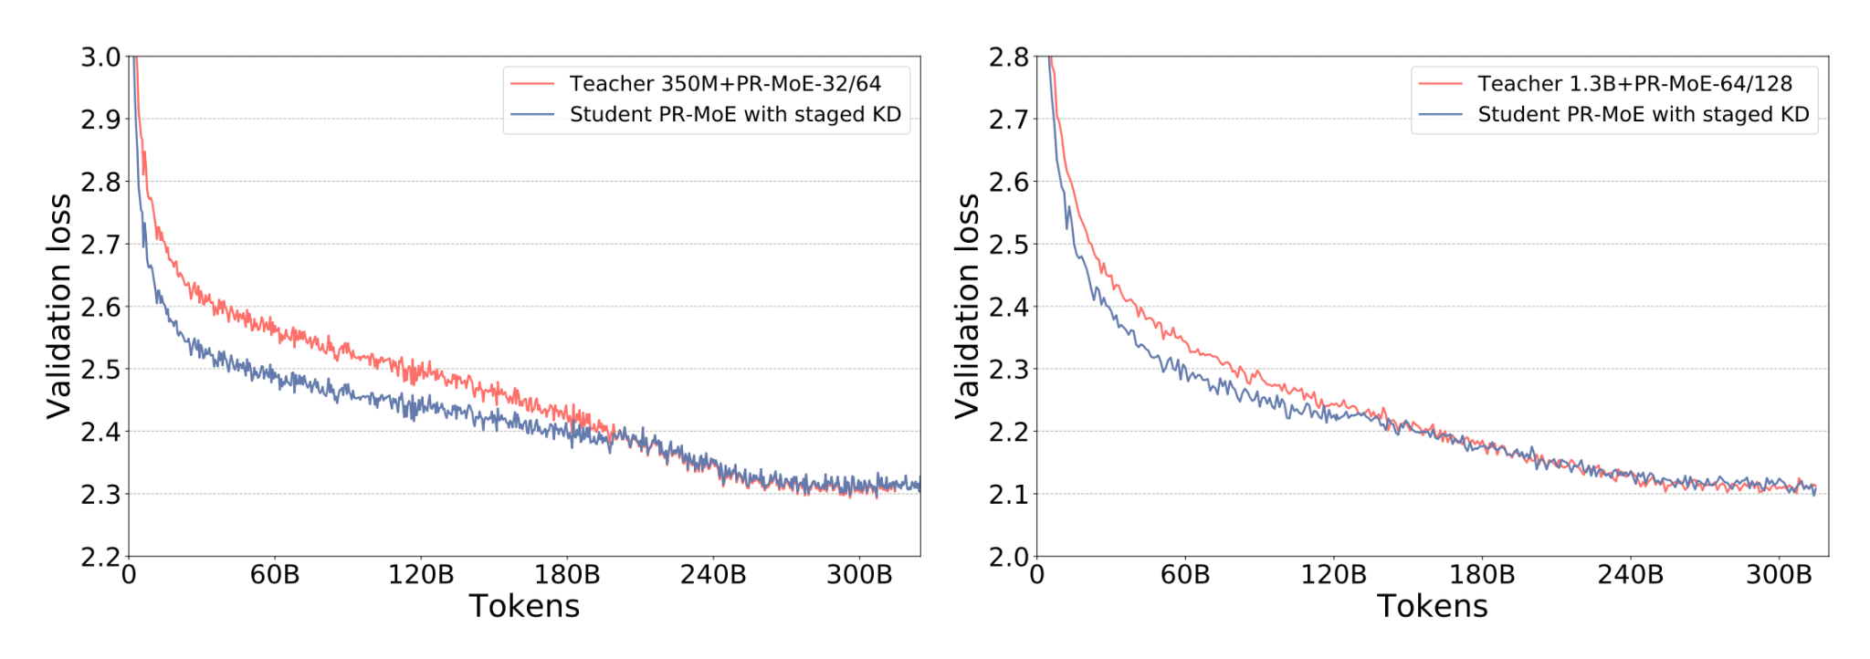
Mixture-of-Students: Evaluation
Observation: Not enough capacity for training and KD loss minimization
Stop KD early in training
Near identical validation loss for 350M+PR-MoE-32/64 and 1.3B+PR-MoE-64/128
Notes:
Vishwa

Slide 30
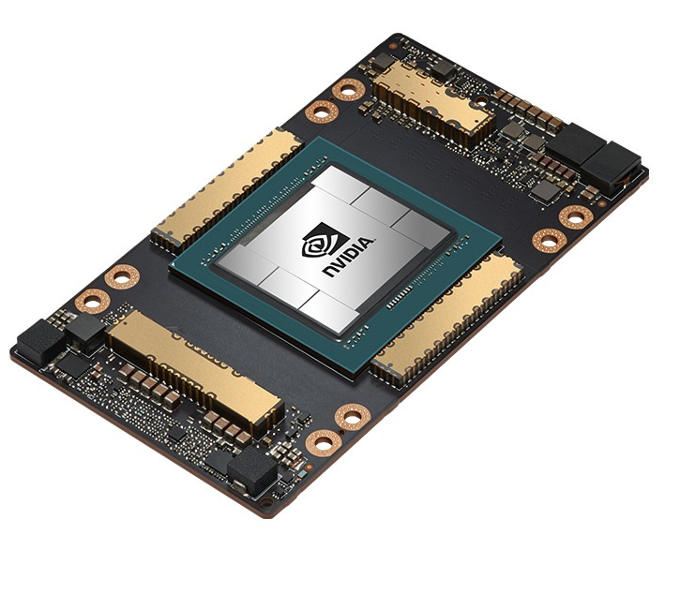
Challenges: Inference
Due to increased size with low parameter efficiency, fast inference is challenging
Larger size requires more GPUs to fit
MoE models may require 10x memory bandwidth to achieve similar latency as dense equivalent models
Notes:
ARI
Multi-gpu inference (eg PyTorch) is not designed to work for MoE models
Inference is often memory bandwidth bound, and since MoE models can be roughly 10x the size of their dense equivalent, low latency may require around 10x larger aggregate memory bandwidth

Slide 31
Inference Solutions - Key Observations
Small batch size in inference
Model size and memory bandwidth main contributors to latency/throughput (for fixed number of devices)
Notes:
ARI
During inference, batch size is generally small, so inference latency of MoE models depends primarily on the time it takes to load the model parameters from main memory
Therefore, the MoE inference performance depends on the overall model size and the achievable memory bandwidth

Slide 32
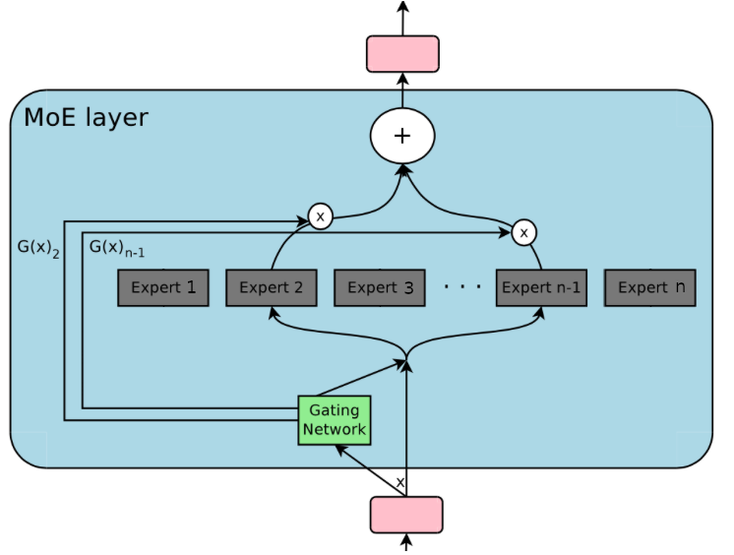
Inference Solutions - Key Observations
Maximum inference parameters:
all tokens collectively go through all parameters… lots of loads/stores
Notes:
ARI
Worst case, the aggregate parameters needed to process all tokens can be as large as the full model (all experts used), which makes it difficult to achieve low latency and high throughput

Slide 33
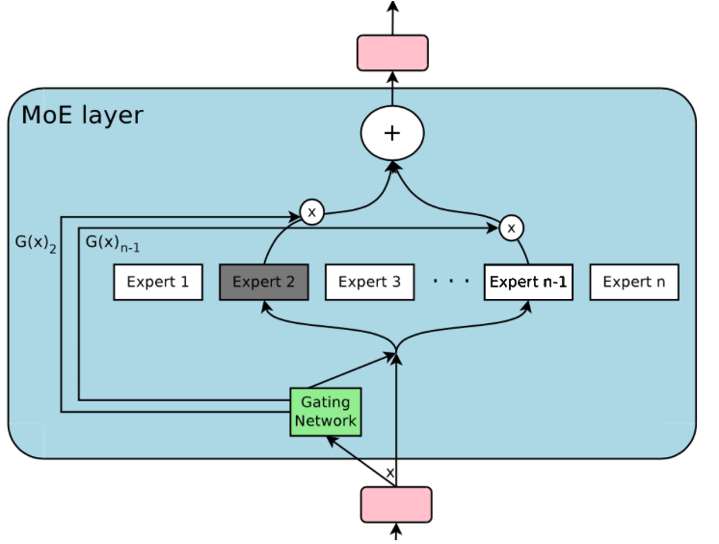
Inference Solutions - Key Observations
Minimum inference parameters:
all tokens collectively go through one expert
Notes:
ARI
Best case, all tokens of an MoE model (top-1) only activates a single expert at each MoE layer, resulting in a critical data path equivalent to the base dense model size
Goal of DeepSpeed is to steer the inference performance towards this view

Slide 34
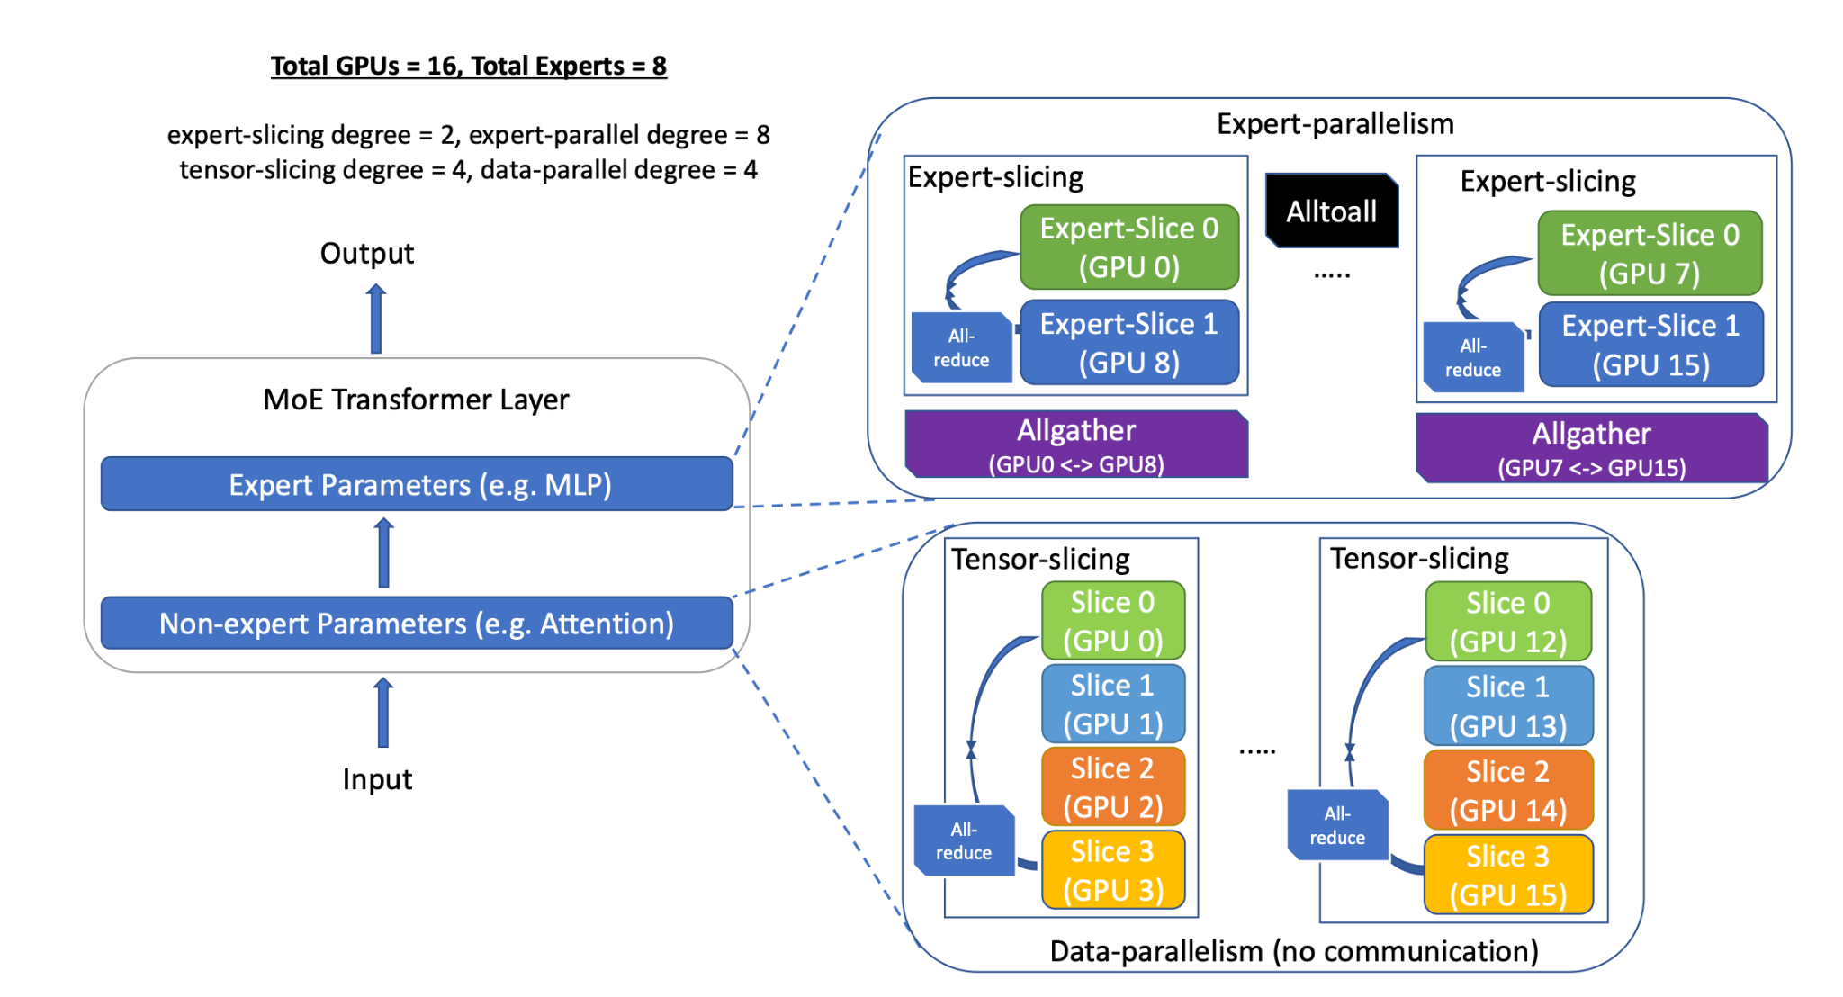
Inference Solutions
Grouping and routing
Expert Parallelism and Expert-Slicing for Expert parameters/processing
Data Parallelism and Tensor-Slicing for Non-Expert parameters/processing
Notes:
ARI
Overview
Partition the model and embrace different methods of parallelism (data/expert)
Group and route tokens with the same critical data path together to reduce data access per GPU to achieve maximum aggregate bandwidth
Optimize communication scheduling
Optimize transformer and MoE related kernels
Experts
Aggregate parameters may be as large as the full model
To address this, experts are partitioned across devices so that each GPU is only responsible for a subset of the experts
Tokens are grouped by which experts they are assigned to, and processing is then parallelized among token groups with different critical data paths
Experts are also sliced to accommodate scenarios where there are more GPUs than experts
Non-Experts
While expert parallelism reduces the number of expert parameters in critical path per device, it does not reduce the number of non-expert parameters in critical path
Tensor slicing and data parallelism within a node addresses this. Each GPU within a node holds a slice of the non-expert parameters. Inter-node slicing is infeasible due to communication overhead

Slide 35
Inference Solutions
Combining expert-parallelism, expert-slicing, tensor-slicing, and data-parallelism allows inference to scale.
Optimized communication collectives and optimized device kernels fully realise the gains
Notes:
ARI
Overview
Partition the model and embrace different methods of parallelism (data/expert)
Group and route tokens with the same critical data path together to reduce data access per GPU to achieve maximum aggregate bandwidth
Optimize communication scheduling
Optimize transformer and MoE related kernels
Experts
Aggregate parameters may be as large as the full model
To address this, experts are partitioned across devices so that each GPU is only responsible for a subset of the experts
Tokens are grouped by which experts they are assigned to, and processing is then parallelized among token groups with different critical data paths
Experts are also sliced to accommodate scenarios where there are more GPUs than experts
Non-Experts
While expert parallelism reduces the number of expert parameters in critical path per device, it does not reduce the number of non-expert parameters in critical path
Tensor slicing and data parallelism within a node addresses this. Each GPU within a node holds a slice of the non-expert parameters. Inter-node slicing is infeasible due to communication overhead

Slide 36
DeepSpeed-MoE Inference Performance
“Overall, DeepSpeed-MoE delivers up to 4.5x faster and up to 9x cheaper MoE model inference compared to serving quality-equivalent dense models using PyTorch.
With benefits that scale with model size and hardware resources, as shown from these results, it makes us believe that MoE models will be crucial to bring the next generation of advances in AI scale.”
Notes:
ARI
Overall, DeepSpeed-MoE delivers up to 4.5x faster and up to 9x cheaper MoE model inference compared to serving quality-equivalent dense models using PyTorch.
With benefits that scale with model size and hardware resources, as shown from these results, it makes us believe that MoE models will be crucial to bring the next generation of advances in AI scale.

Slide 37
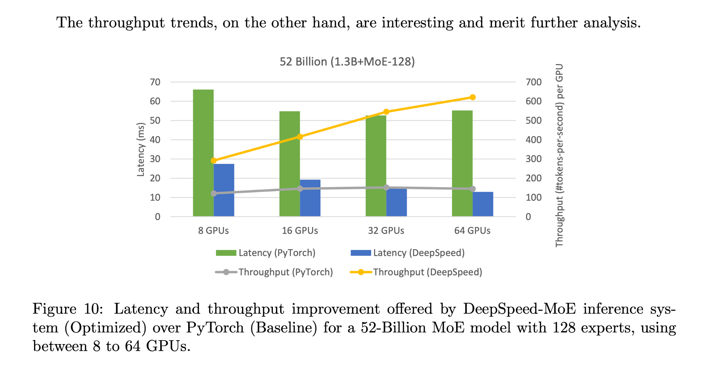
DeepSpeed-MoE Inference Performance
Notes:
ARI
Serving MoE models on PyTorch vs DeepSpeed (optimized) – Scaling up GPU shows super linear aggregate throughput

Slide 38
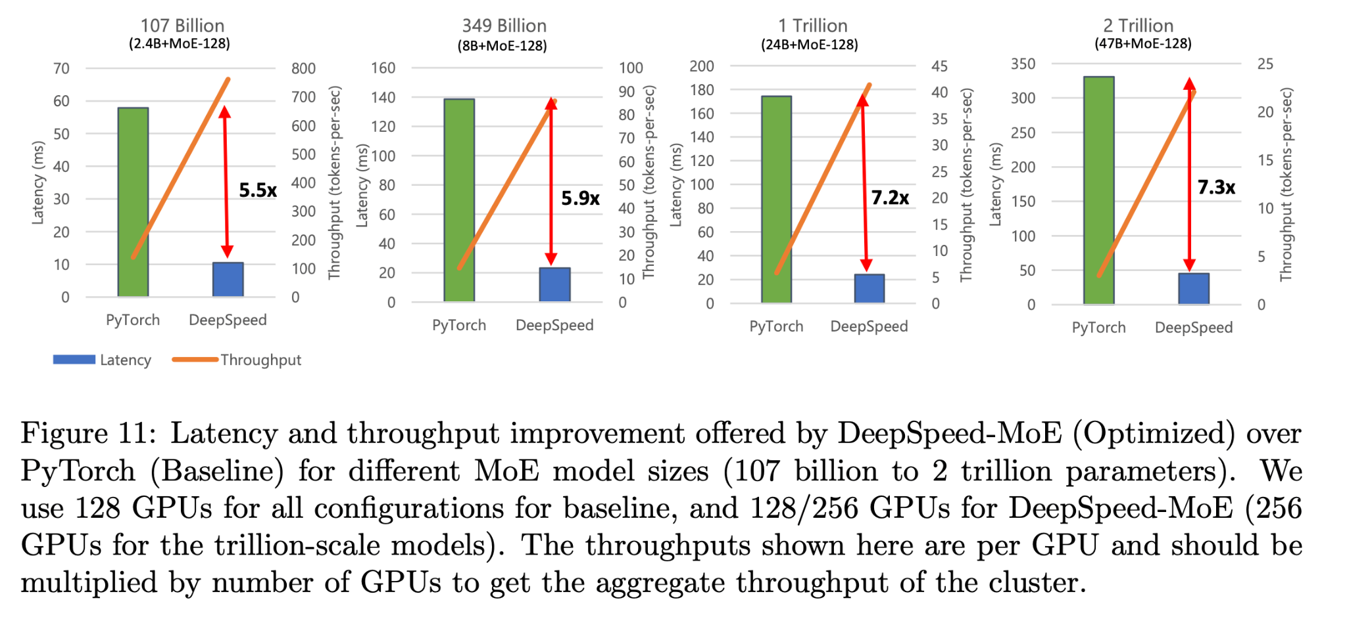
DeepSpeed-MoE Inference Performance
Notes:
ARI
Serving MoE models on PyTorch vs DeepSpeed (optimized) – Scaling up size of the model shows up to 7.3x latency improvement and 7.3x throughput improvement

Slide 39
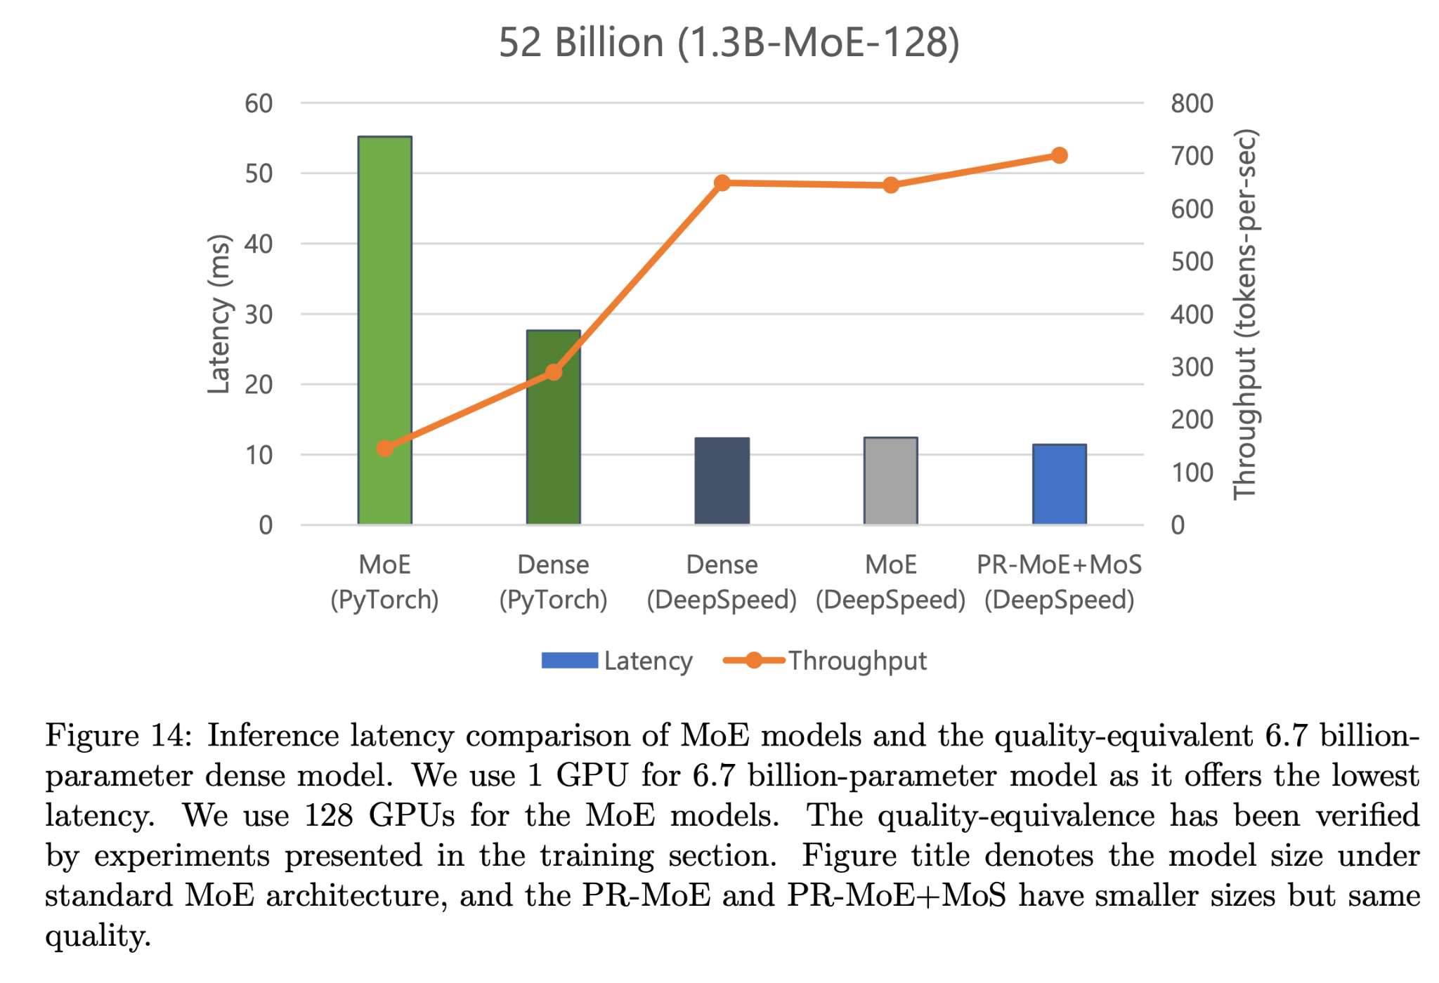
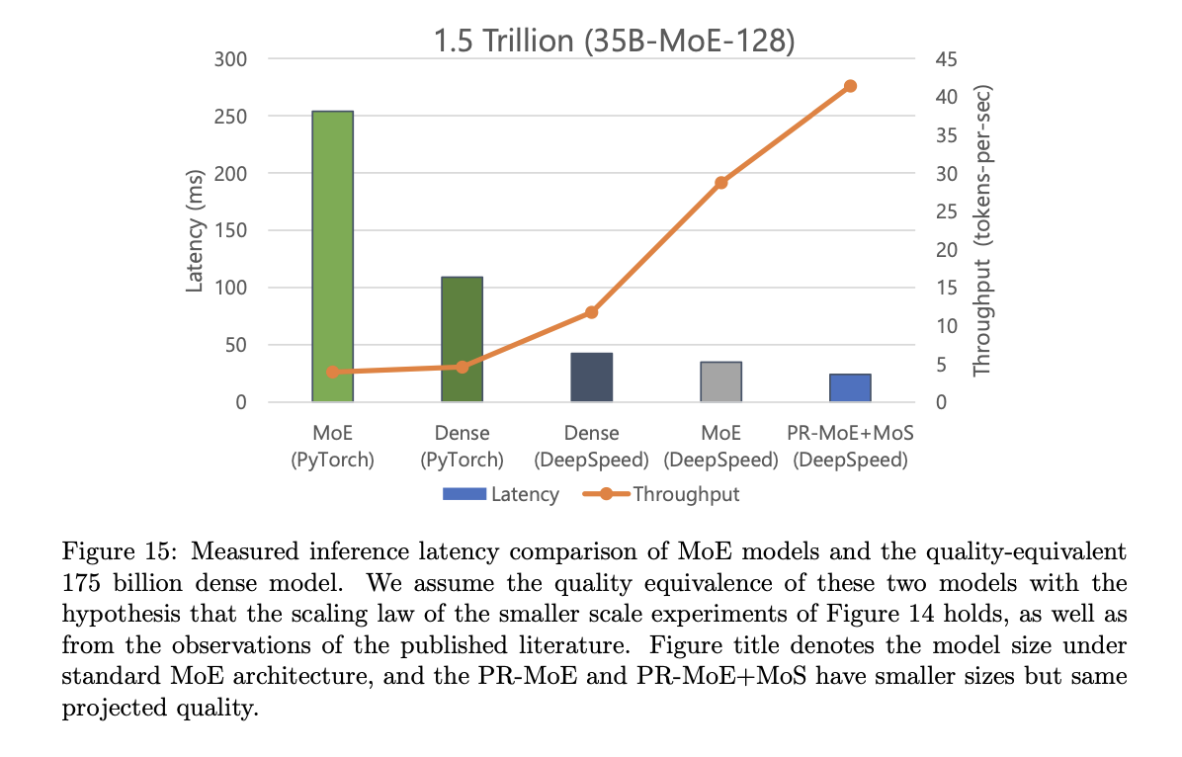
DeepSpeed-MoE Inference Performance
Notes:
ARI
DeepSpeed MoE allows similar latency/throughput performance of a quality equivalent dense model. PyTorch does not achieve this

Slide 40
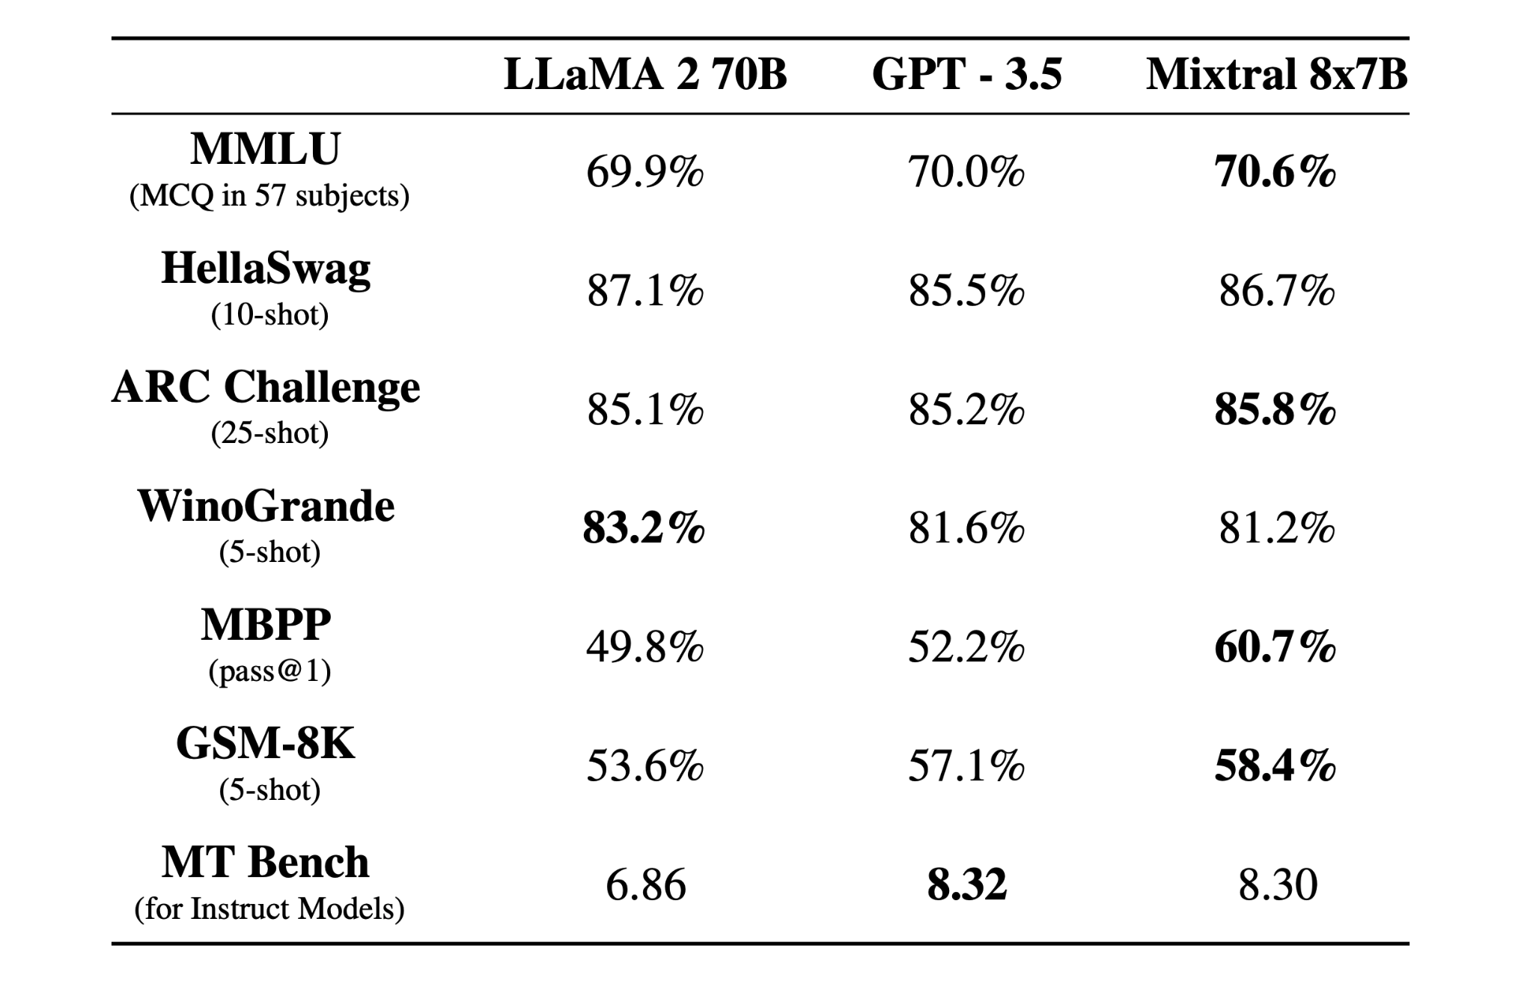
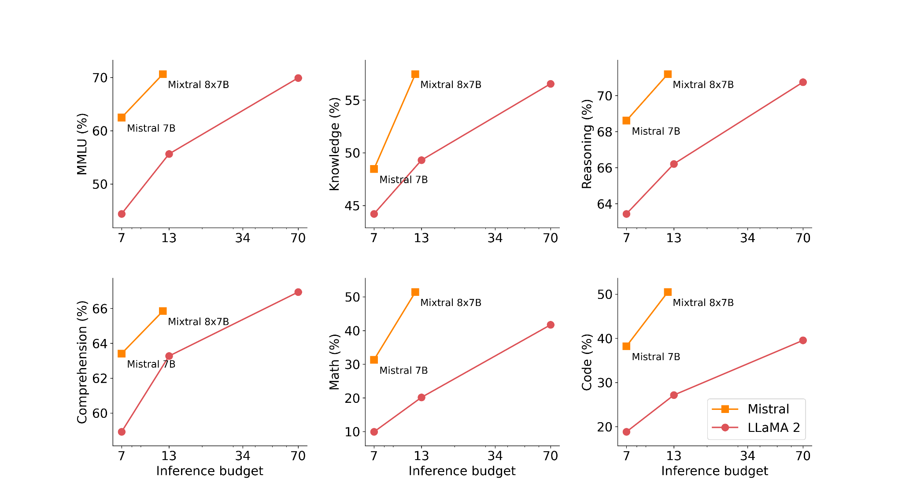
Mixtral - Mistral Mixture of Experts
Out performs LLaMA 2 and GPT 3.5
6x faster inference
Notes:
Jack
Generative text model for natural language generation
Sparse Mixture of Experts, 8 Experts with gating function choosing 2 at each step
Increases the number of parameters of a model while controlling cost and latency
Out performs LLaMA 2 and GPT 3.5
6x faster inference

Slide 41
Conclusion & Future Work
Achievements:
Reduce MoE train/inference costs
Reduce MoE memory requirements
Improve MoE inference performance
Step towards real world application
Notes:
Vishwa
Hardware requirement limitations means just increasing dense model size isn’t realistic
Achievements:
Reduce training cost of NLG models
Use PR-MoE and MoS to reduce memory requirements
Reduce latency and cost for MoE inference
Began shift from dense to sparse MoE models
Enabled real-world deployment of MoE models
Still a new idea and has potential to be applied to many different types of models for quality/cost improvement

